Slide 1
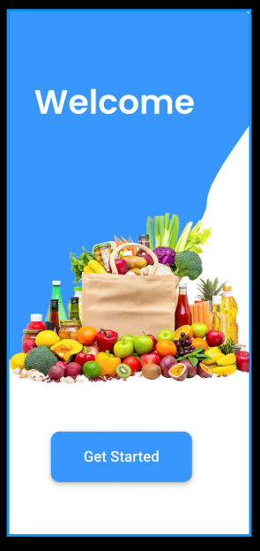
Super Shopper
High-Fidelity ECommerce UX/UI Case Study
Seamless Navigation and Micro-interactions for Modern Mobile Commerce
Objective: Creating an end-to-end shopping journey with a focus on user feedback and logical flow

Slide 2
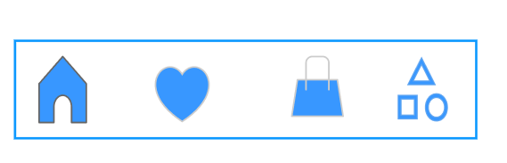
The Problem & Solution
Problem: Users often feel overwhelmed by diverse e-commerce categories, leading to high drop-off rates during the search and checkout phase
Solution:
Designed a centralized 3-line menu for rapid category access
Implemented global "Home" navigation to ensure zero-point failure in the user journey
Built state-driven feedback (animated likes/verifications) to increase user confidence

Slide 3
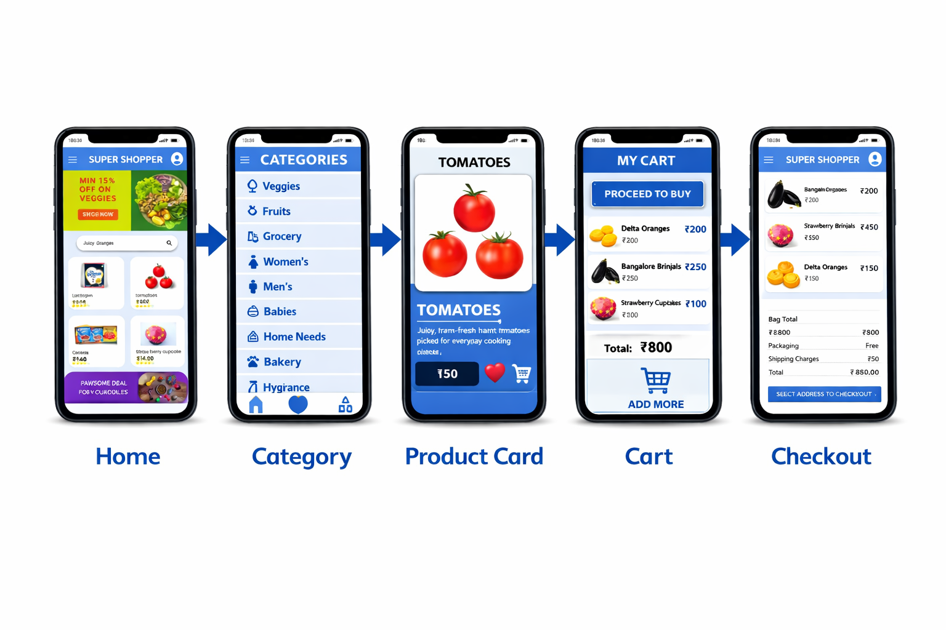
The Seamless Path to Purchase
Global Navigation: Persistent "Home" and "Menu" access across all screens
Categorical Depth: Logical grouping from "Fresh Produce" to "Personal Care"
HOME
CATEGORY
PRODUCT
CART
CHECKOUT

Slide 4
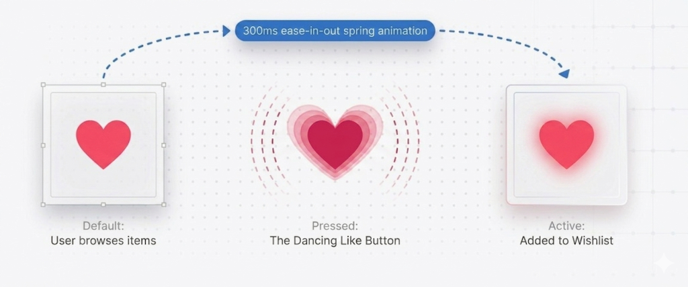
Micro-interactions that Build Confidence
❤️ Like button → visual feedback for wishlist
🔐 Payment verification → simulates real transaction flow
🔍 Product cards → deep navigation without losing context
🧭 Consistent navigation → no dead ends
Each interaction reinforces user confidence and reduces uncertainty

Slide 5
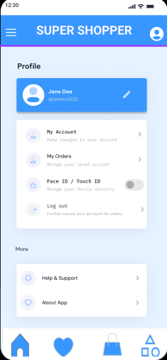
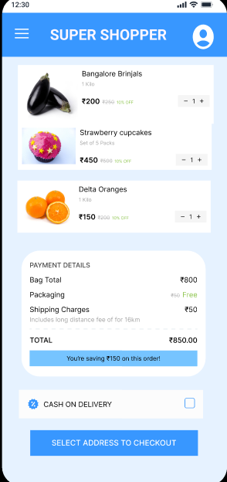
Beyond UI — Thinking in Systems
Trackable Events
Product clicks Cart interactions Checkout drop-offs
Design Structure
Modular components Reusable UI patterns Consistent layout system
User Experience Focus
Clear visual hierarchy Accessible typography Guided navigation flow
Data Potential Behavior-driven recommendations Conversion optimization through user insights

Slide 6
Prototype Scope & Simulation Strategy
What’s Implemented
Full navigation flow
Interactive elements
Multi-step checkout simulation
What’s Simulated
Cart persistence (no backend)
Payment verification logic
VS
The prototype focuses on user flow and interaction design, while backend logic is intentionally simulated.”

Slide 7
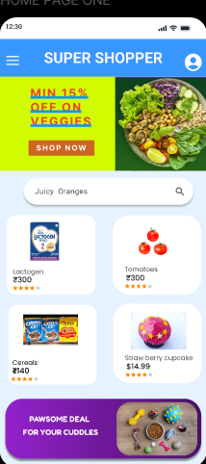
What This Project Demonstrates
Impact
100% navigable prototype
Zero dead-end screens
Realistic e-commerce flow simulation
Skills Proven
UX thinking
Interaction design
Product thinking
Data-aware design
Learning
Designing is not just about screens, but about guiding user decisions.

Slide 8
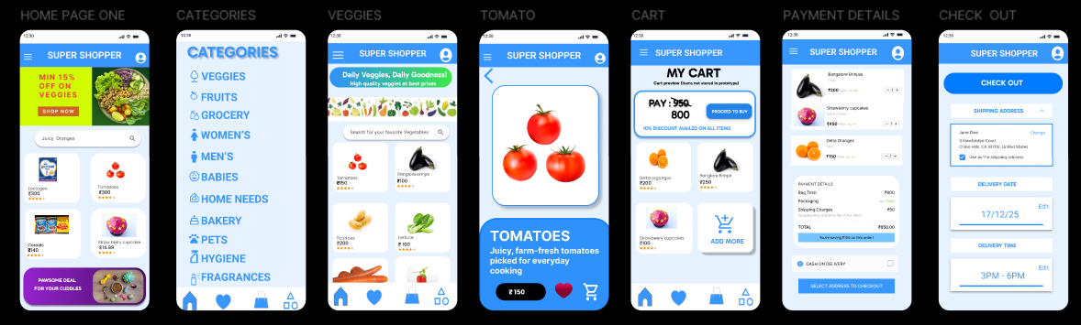
Clean multi-screen layout (Home, Cart, Checkout)
LIVE PROTOTYPE LINK : https://www.figma.com/proto/7whAVoiaY3yX72eTBVGQsh/E-COMMERCE---GROCERY-APP?node-id=53-2&t=gMmHCTOl75pDqsCd-1

